Slide 1

Customer Churn Prediction For Banking Sector
HARMAN BHUTANI
RAHUL RAJ SHARMA
ARPIT RATHORE

Slide 2

Agenda
Introduction : Customer Churn & Use in banking
Business Challenges & Project Objective
System Overview
Data Setup
Pre-Analytics
Model Development
Evolution
Execution
Results
Conclusion
Notes:
Need to do this properly which will include all the important points

Slide 3

Customer Churn
Customer churn is when an existing customer, user, player, subscriber or any kind of return client stops doing business or ends the relationship with a company
Customer churn has become a major problem within a customer centred banking industry and banks have always tried to track customer interaction with the company, in order to detect early warning signs in customer's behaviour such as reduced transactions, account status dormancy and take steps to prevent churn
Churn rate usually lies in the range from 10% upto 30%
Notes:
Availability of latest technology
customer -friendly bank
Low interest rate
Locations
Services offered

Slide 4
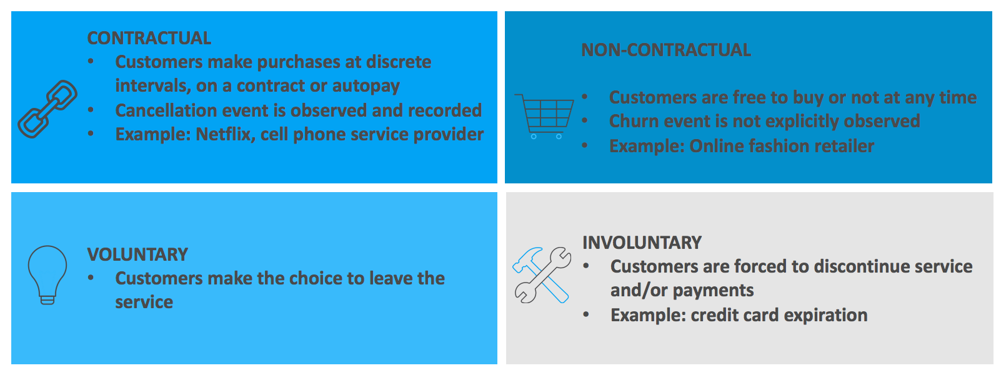
Churn Prediction Importance In Banking

Slide 5
Project Objective
Project Objective
The object to show customer churn process for a bank and how the business analytics will work in predicting those churn customers and benefits the bank
Business Objective
For the bank, objective are to gain insights from its past data, and to identify customers any stage of their lifecycle who are currently active but are likely to become inactive
Model Objective
The model would rank each customer between 0 and 1 on the basis of their probability to churn based on the 6 months historical behaviour
Target Base
Total data of 10,000 customers with 14 columns

Slide 6
Approach For Churn Prediction
Data Setup
Pre-Analytics
Model Development
Evaluation
Execution
Collect the right data and set up ADS - analytical datastore for modeling
Identify the main static, demographic and behaviour levers and their influences on dormancy to understood correlation based on available data
Develop a propensity model to rank the subscribers based on their likelihood to churn/ become inactive
Comparative evaluation of various modeling techniques and the best performing model will be selected
Design retention campaigns
Set up test and control groups
Execute and measure results from campaign

Slide 7
Data Setup
Pre-Analytics
Model Development
Evaluation
Execution

Slide 8
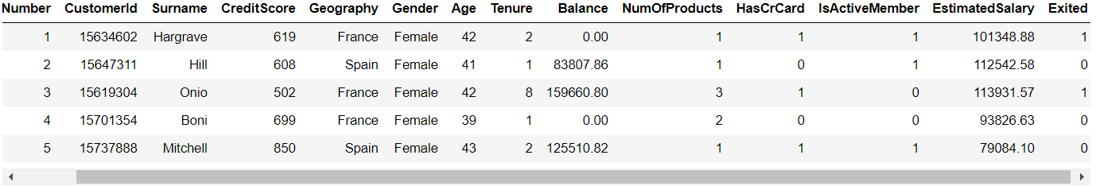
Data Information
Above data set of the bank showed the variables over which we need to perform the data analytics application to find out the churn customers
70% of the time, the data scientist is busy working on setting up the data, cleansing the data and profiling the data for feature engineering

Slide 9
Features
Features | Details | Features | Details
RowNumber | Index no. of row | Tenure | How long customer with bank
CustomerId | Customer ID | Balance | Current balance in account
Surname | Last name of customer | NumOfProducts | Prod. taken by cust.
CreditScore | Credit score given by bank | HasCrCard | Owning credit card or not
Geography | Country of customer | IsActiveMember | Active or not
Gender | Gender of customer | EstimatedSalary | Annual salary of customer
Age | Age of customer | Exited | Cust. still with bank or not
Notes:
Talks about each variable of the data set and what it represents as per the table

Slide 10
Categorical & Numerical Features
Categorical Features Variable that are fixed or limited number of possible values assigning each individual or other unit of observations
Numerical Features These variables are numerical and have meaning as measurement
Geography | France,germany, Spain
Gender | Male, Female
NumOfProducts | 1, 2, 3, 4
HasCrCard | 0 = No, 1 = Yes
IsActiveMember | 0 = No, 1 = Yes
CreditScore | Numerical value given by bank
Age | Customer age
Tenure | Using services
Balance | Current balance
EstimatedSalary | Annual salary

Slide 11
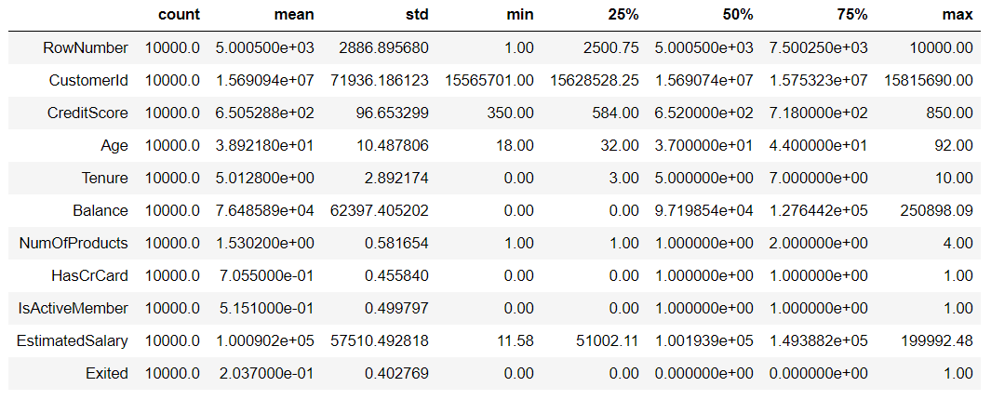
Descriptive Statistics
Notes:
Need to talk about the mean, max, min and quarterly analysis of the data received from the bank for analysis

Slide 12
Outliers Detection
Outliers are extreme values that deviate from other observations on data , they may indicate a variability in a measurement, experimental errors or a novelty.
Box Plot
A boxplot is a standardized way of displaying the distribution of data based on a five number summary (“Minimum”, First Quartile (Q1), Median (Q2), IQR, Third Quartile (Q3), and “Maximum”)
Notes:
In data mining, anomaly detection (also outlier detection) is the identification of rare items, events or observations which raise suspicions by differing significantly from the majority of the data. ... Anomalies are also referred to as outliers, novelties, noise, deviations and exceptions.
if a data point is below Q1 – 1.5×IQR or above Q3 + 1.5×IQR, it is viewed as being too far from the central values to be reasonable.

Slide 13
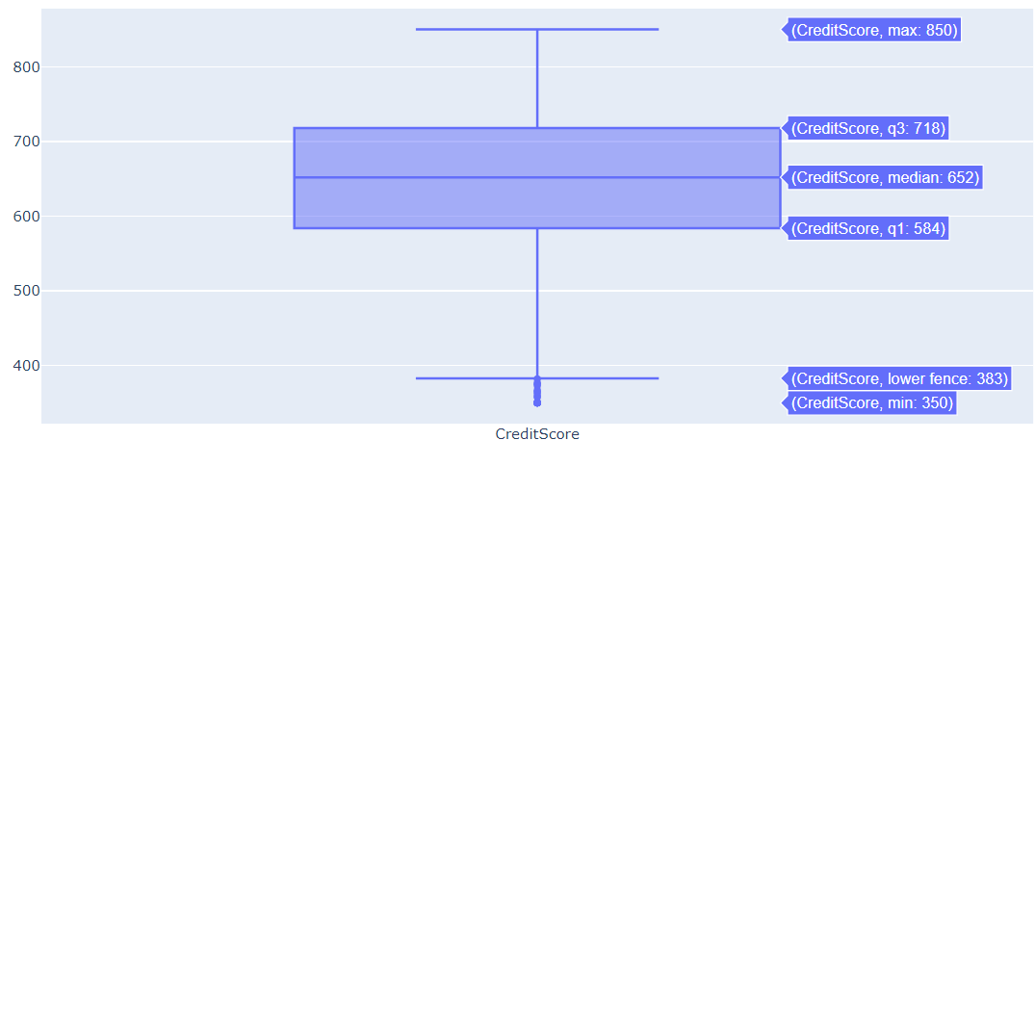
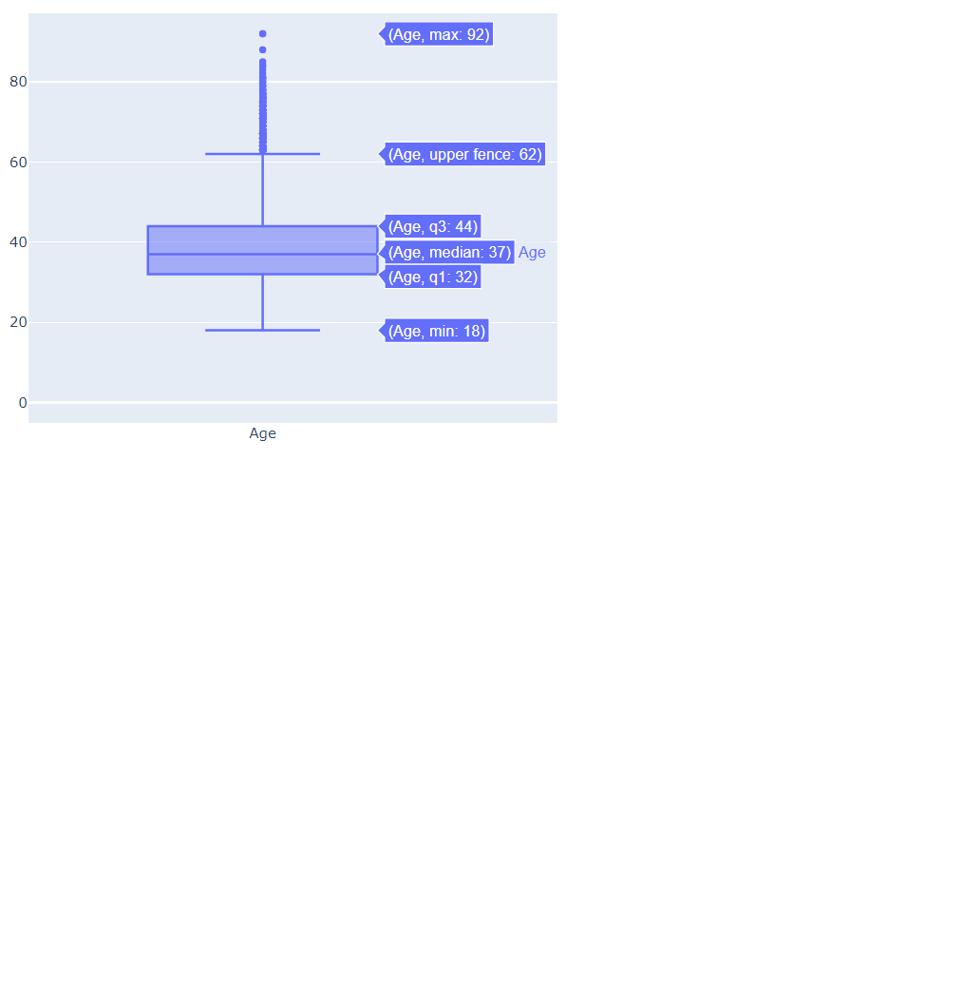
CreditScore
Age

Slide 14
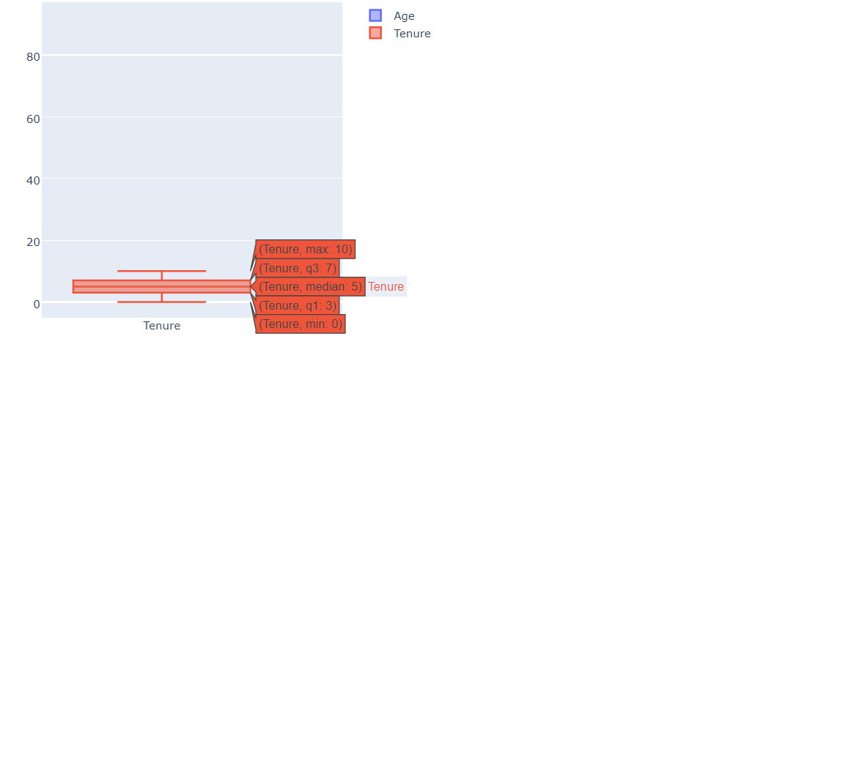
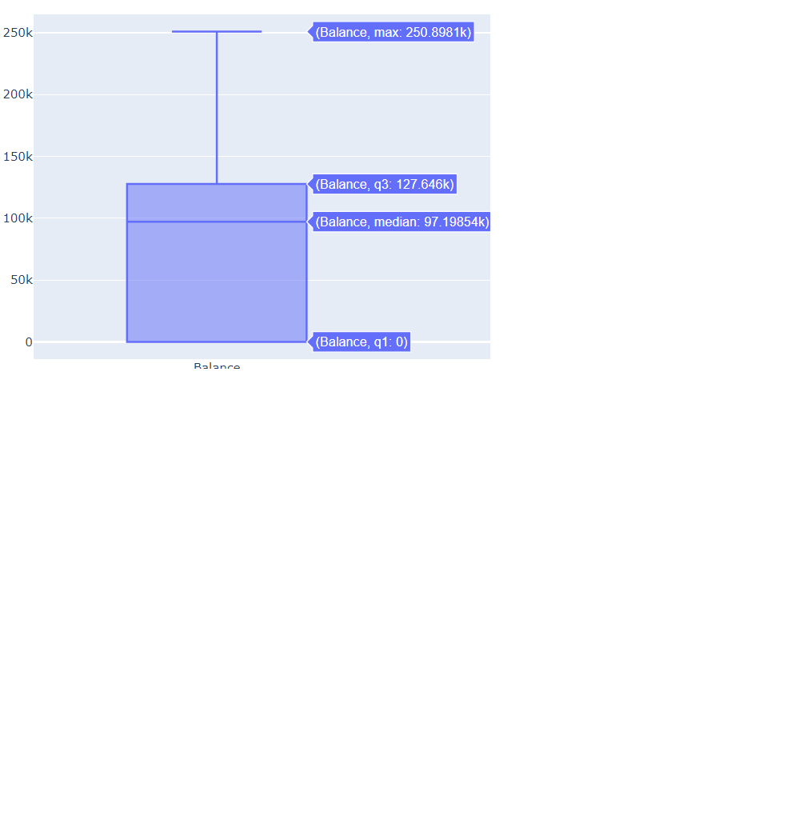
Tenure
Balance

Slide 15
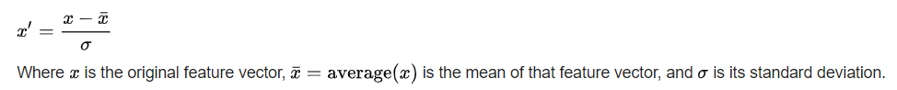
Features Scaling
Feature scaling is a method used to normalize the range of independent variables or features of data
We have normalize the dataset using standardization mechanism
Feature standardization makes the values of each feature in the data have zero-mean (when subtracting the mean in the numerator) and unit-variance.

Slide 16
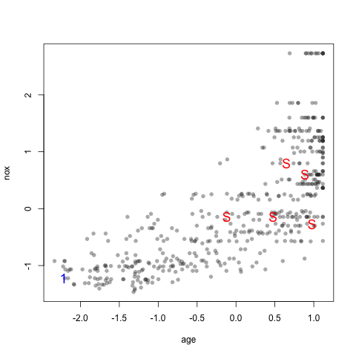
Data Splitting ( Train, Validation, Test)
Dataset is divided into three groups Training dataset, Validation dataset and Test dataset
Total Samples= 10,000
Training Samples = 7,000
Validation Samples = 1,000
Testing Samples = 2,000

Slide 17
Data Setup
Pre- Analytics
Model Development
Evaluation
Execution

Slide 18
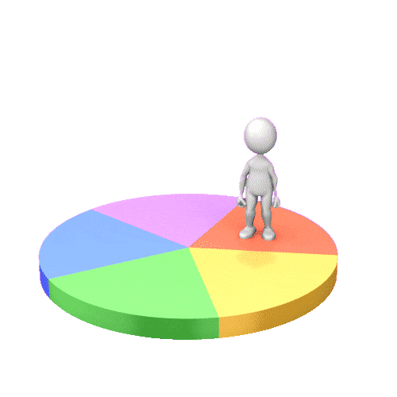
Categorical Data Visualization

Slide 19
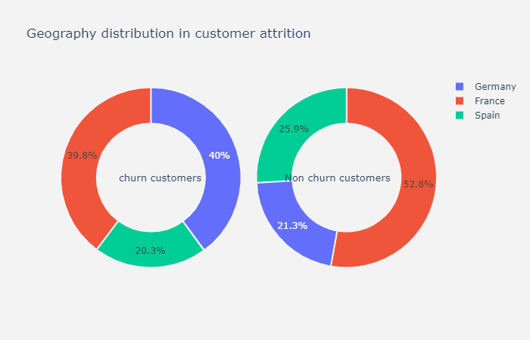
Geography
Division of data on the basis of categorical variable Geography.
These 2 pie chart shows the number of customer in each country divided as churn customers and non-churn customers
Used to compare the churn and non-churn ratio as per the country

Slide 20
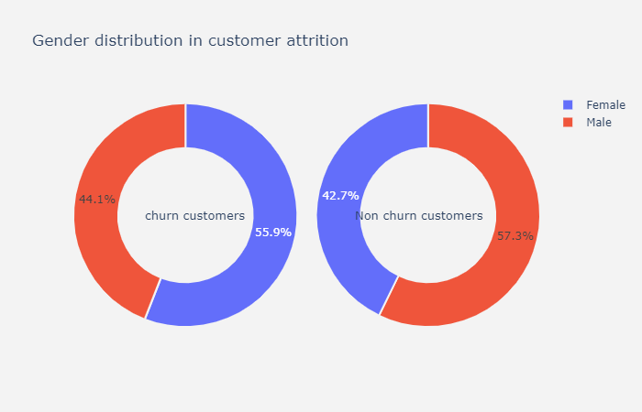
Gender
Division of data on the basis of categorical variable gender
These 2 pie chart shows the number of customer divided as churn customers and non-churn customers of the basis of gender
This will give the insight view of customers on the basis of gender

Slide 21
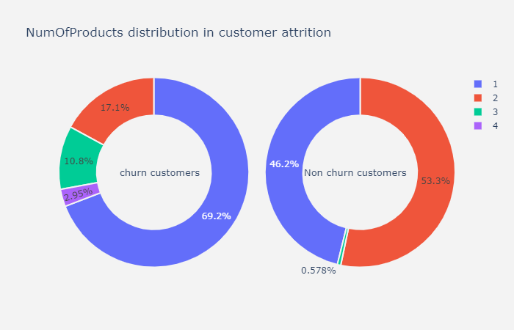
Number of Products
Division of data on the basis of categorical variable number of products
These 2 pie chart shows the number of customer divided as churn customers and non-churn customers of the basis of number of products/services that are used by those customers
This will give us the ratio between how much services used and they churn

Slide 22
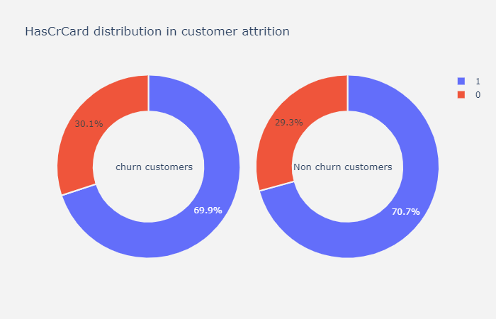
Has Credit Card
Division of data on the basis of categorical variable HasCrCard which shows customer has a credit card or not
These 2 pie chart shows the number of customer divided as churn customers and non-churn customers of the basis of credit card whether they have it or not
This will give us the ratio between customer churn which has credit card or not having it

Slide 23
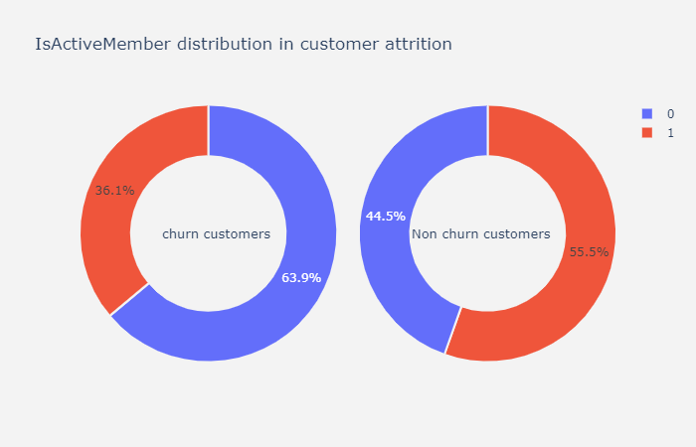
Is Active Member
Division of data on the basis of categorical variable IsActiveMember
These 2 pie chart shows the number of customer divided as churn customers and non-churn customers of the basis of whether the customer is active member or not
This will give us the ratio between customer churn which are active or not

Slide 24
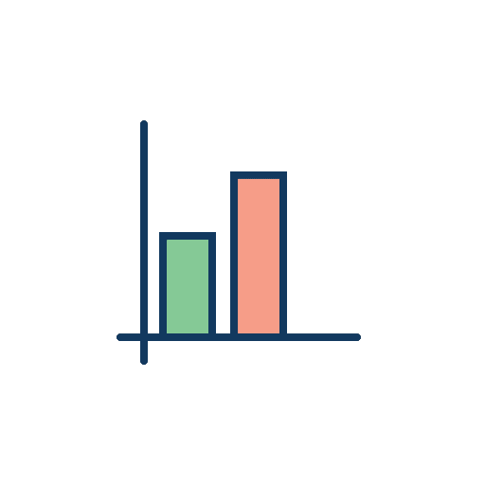
Numerical data Visualization

Slide 25
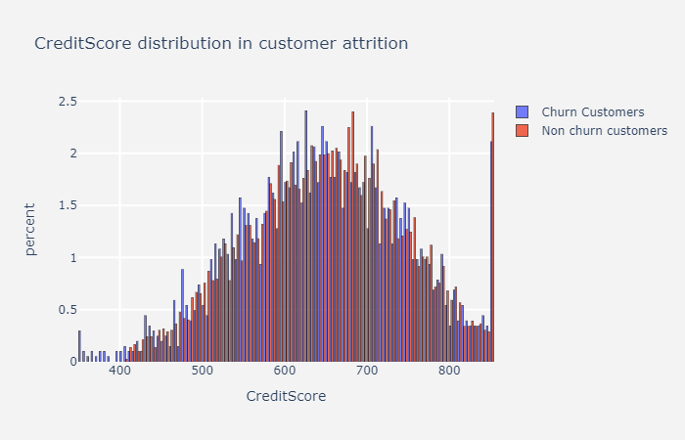
Credit Score
Division of data on the basis of Numerical variable Credit Score
Histogram will show the customers that are churn or non churn on the basis of their credit scores
This will give us the ratio between customer churn which are having high credit score or low credit score
Mean(Churn) : 625-629
Mean(Non churn) : 680-684

Slide 26
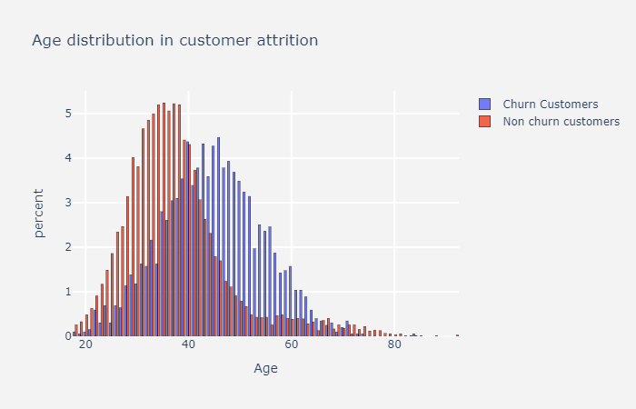
Age
Division of data on the basis of Numerical variable Age
Histogram will show the customers that are churn or non churn on the basis of their Age
This will give us the ratio between customer churn Age and non churn customers age
Mean(Churn) : 46
Mean(Non churn) : 35

Slide 27
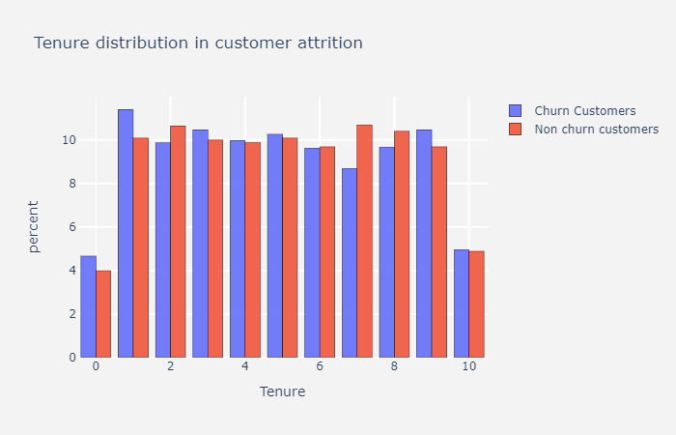
Tenure
Division of data on the basis of Numerical variable Tenure
Histogram will show the customers that are churn or non churn on the basis of their Tenure
This will give us the ratio between customer churn that are using services from how much time
This will give an idea about after how much time the customers are usually churn

Slide 28
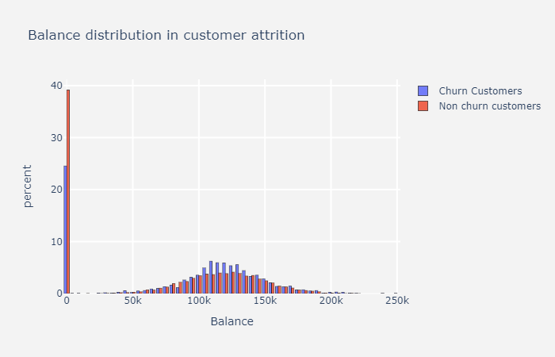
Balance
Division of data on the basis of Numerical variable Balance
Histogram will show the customers that are churn or non churn on the basis of their Balance available in account
This will give us the ratio between customer churn having balance in account or not
Mean(Churn) : 107.5K - 112.5K
Mean(Non churn) : 112.5K - 117.5K

Slide 29
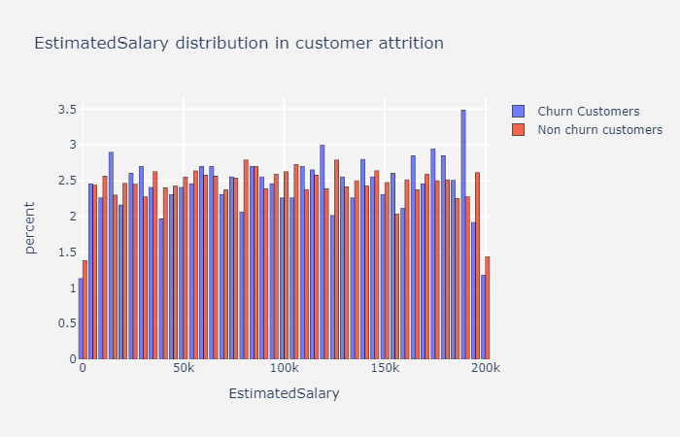
Estimated Salary
Division of data on the basis of Numerical variable Salary
Histogram will show the customers that are churn or non churn on the basis of their Salary which will be credit in account
This will give us the ratio between customer churn having salary account or not
This will give us an idea about whether churn depends on the salary or not

Slide 30
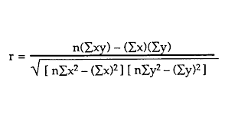
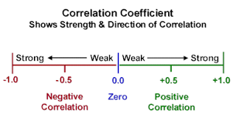
Correlation
Notes:
The correlation coefficient is a statistical measure that calculates the strength of the relationship between the relative movements of two variables. The values range between -1.0 and 1.0. A calculated number greater than 1.0 or less than -1.0 means that there was an error in the correlation measurement. A correlation of -1.0 shows a perfect negative correlation, while a correlation of 1.0 shows a perfect positive correlation. A correlation of 0.0 shows no relationship between the movement of the two variables

Slide 31
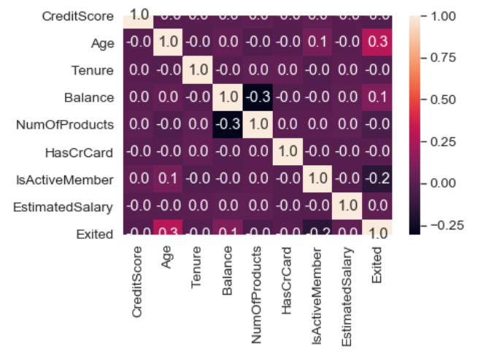
Heat map : Correlation Table
Notes:
A heat map (or heatmap) is a graphical representation of data where the individual values contained in a matrix are represented as colors. "Heat map" is a newer term but shading matrices have existed for over a century

Slide 32
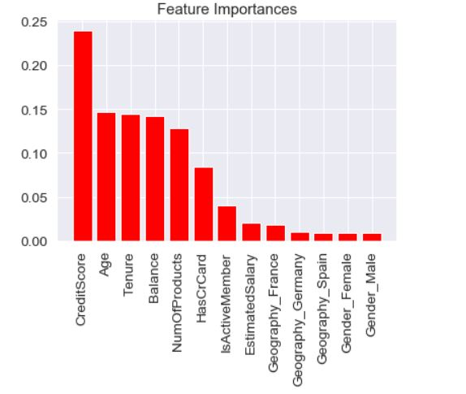
Feature Selection
Random Forest Classification Algorithm
10,000 Decision Tree
Gini Index
Notes:
Feature Selection is the process where you automatically or manually select those features which contribute most to your prediction variable or output in which you are interested in. Having irrelevant features in your data can decrease the accuracy of the models and make your model learn based on irrelevant features

Slide 33
Data Setup
Pre-Analytics
Model Development
Evaluation
Execution

Slide 34
Why Neural Network?
Neural Networks have the ability to learn by themselves and produce the output that is not limited to the input provided to them.
These networks can learn from training data and apply them when a similar event arises, making them able to work through real-time events.
Even if a neuron is not responding or a piece of information is missing, the network can detect the fault and still produce the output.
They can perform multiple tasks in parallel without affecting the system performance.
Corruption of one or more cells of ANN does not prevent it from generating output. This feature makes the networks fault-tolerant.

Slide 35


Neural Network Framework

Slide 36
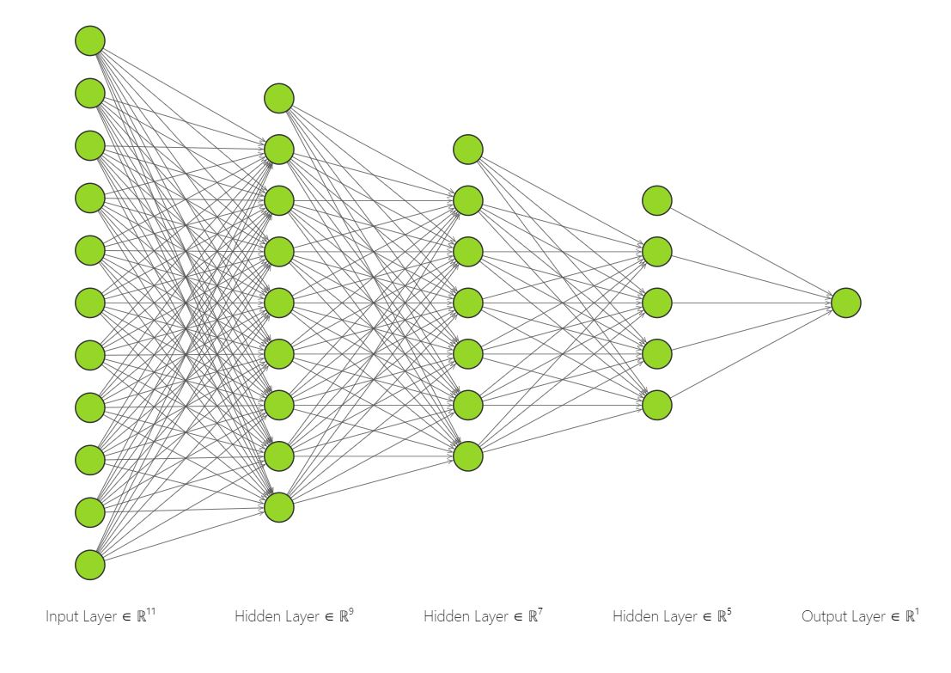
Neural Network Snapshot

Slide 37
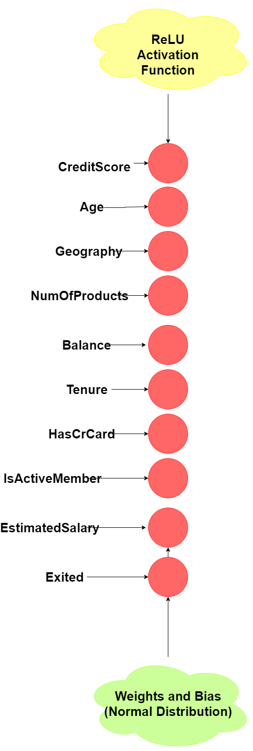
Input Layer

Slide 38
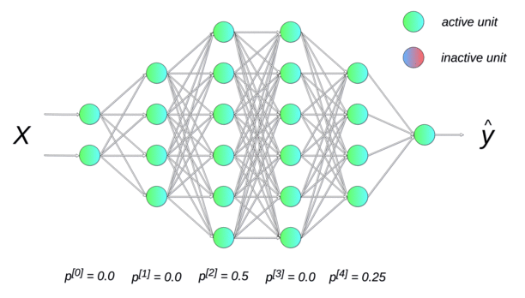
Dropout Layer

Slide 39
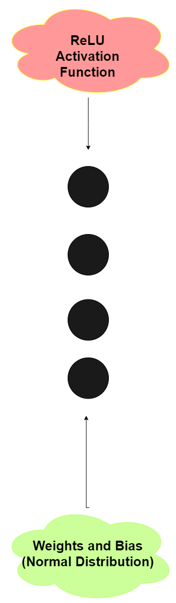
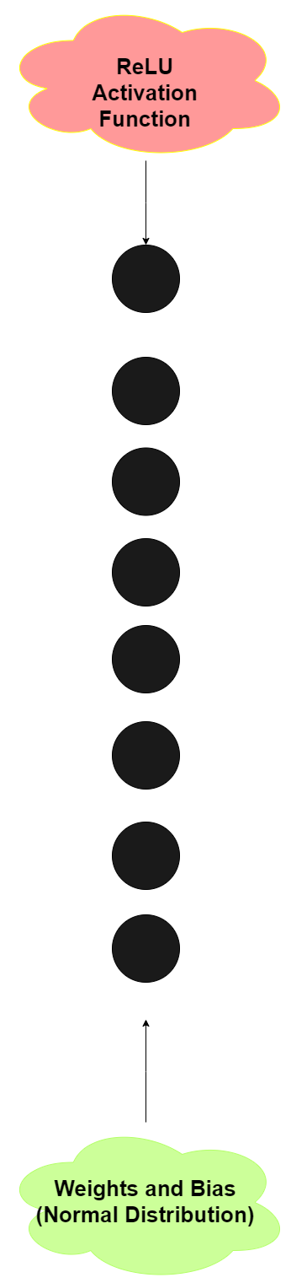
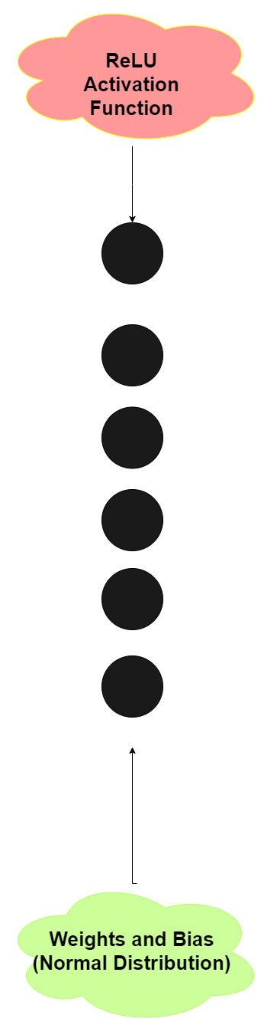
Hidden Layers

Slide 40
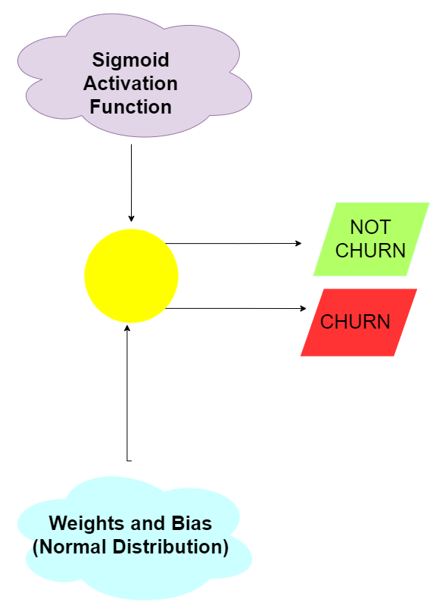

Output Layer

Slide 41
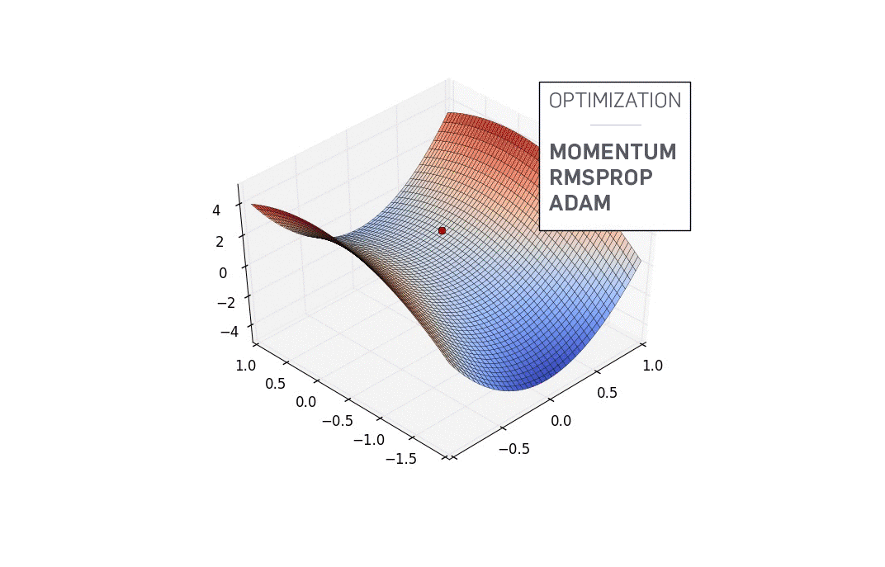
Weight Optimization

Slide 42
Data Setup
Pre-Analytics
Model Development
Evaluation
Execution

Slide 43
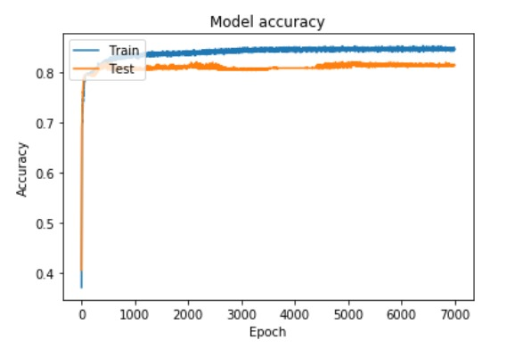
Accuracy Graph
The exponential increase in the accuracy of our model shows the the progress of training of NN

Slide 44
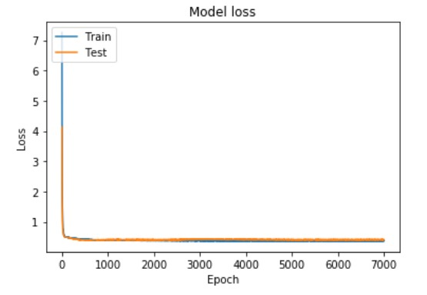
Loss Graph
The representation of training and testing loss depicts that our model is trained correctly.
Overfitting if: training loss << validation loss
Underfitting if: training loss >> validation loss
Just right if training loss ~ validation loss

Slide 45
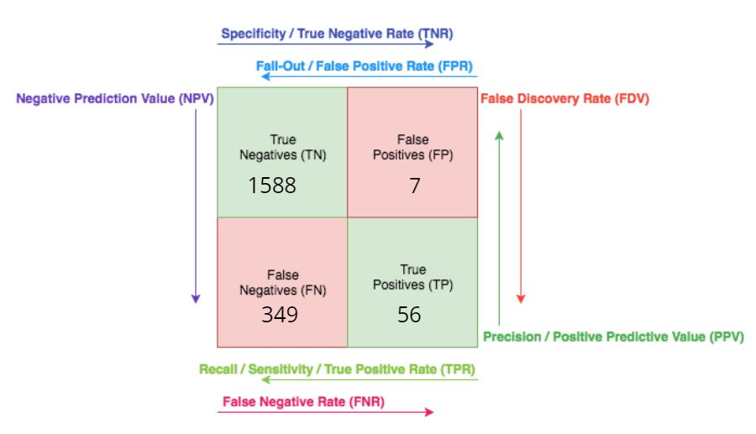
Confusion Matrix

Slide 46
Confusion Matrix Measures
Measure | Value | Derivations
Sensitivity | 0.82 | TPR = TP / (TP + FN)
Specificity | 0.89 | SPC = TN / (FP + TN)
Precision | 0.99 | PPV = TP / (TP + FP)
Accuracy | 0.83 | ACC = (TP + TN) / (P + N)
F1 Score | 0.89 | F1 = 2TP / (2TP + FP + FN)

Slide 47
Data Setup
Pre-Analytics
Model Development
Evaluation
Execution

Slide 48

Project Details
https://github.com/rarpit1994/Churn-Prediction

Slide 49
Conclusion
The Neural Network model was built based on certain important factors which resulted in accurate filtration of output layer.
With increase in epochs , the accuracy of the model increased exponentially.
The complex layers which worked in the backend was an important aspect because it formed a perfect base for the whole model to flourish exceedingly well.

Slide 50
References
Brandusoiu, I., Toderean, G., & Beleiu, H. (2016). Methods for churn prediction in the prepaid mobile telecommunications industry. IEEE International Conference on Communications, 2016-August(April 2017), 97–100. https://doi.org/10.1109/ICComm.2016.7528311
Sung, C., Higgins, C. Y., Zhang, B., & Choe, Y. (2017). Evaluating deep learning in chum prediction for everything-as-a-service in the cloud. Proceedings of the International Joint Conference on Neural Networks, 2017-May, 3664–3669. https://doi.org/10.1109/IJCNN.2017.7966317
Bruce, 2011. (2013). 済無No Title No Title. Journal of Chemical Information and Modeling, 53(9), 1689–1699. https://doi.org/10.1017/CBO9781107415324.004
Günay, M. (2018). Makine Ö ğ renmesi Yöntemleri ile Kay ı p Mü ş teri Analizi Predictive Churn Analysis with Machine Learning Methods. 2018 26th Signal Processing and Communications Applications Conference (SIU)
Chen, Y. B., Li, B. S., & Ge, X. Q. (2011). Study on predictive model of customer churn of mobile telecommunication company. Proceedings - 2011 4th International Conference on Business Intelligence and Financial Engineering, BIFE 2011, 114–117. https://doi.org/10.1109/BIFE.2011.112
Kübra, Ş., & Güler, N. (2015). Bankac ı l ı kta Mü ş teri Terk Modeli Customer Churn Modelling in Banking.
Martins Kummer, L. B., Cesar Nievola, J., & Paraiso, E. C. (2018). Applying Commitment to Churn and Remaining Players Lifetime Prediction. IEEE Conference on Computatonal Intelligence and Games, CIG, 2018-August. https://doi.org/10.1109/CIG.2018.8490443
Tsai, C. F., & Lu, Y. H. (2009). Customer churn prediction by hybrid neural networks. Expert Systems with Applications, 36(10), 12547–12553. https://doi.org/10.1016/j.eswa.2009.05.032

Slide 51
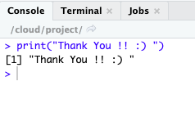

Slide 52


